Slide 1
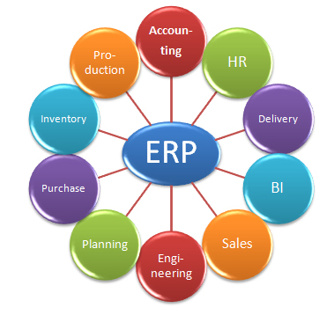
ERP SYSTEM

Slide 2

Why we need it ?
It's taking longer and longer to reconcile financials at the end of the month. Your sales forecasts are based more on guesswork than solid figures. Your business is having trouble keeping up with its order volume and customer satisfaction is faltering as a result. You have no idea how much inventory you have in your warehouse, and it's a pain to find out. If this sounds like your business—or close to it—then it may be time to consider an ERP system.
Because every company is unique, there's no single indicator that says, "You need ERP now!"

Slide 3

Is your Company ready for ERP?
However, the companies that would benefit most from ERP software often face similar problems and frustrations. There are top five signs and the company is ready for ERP.

Slide 4
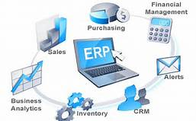
1.You Have Lots of Different Software for Different Processes
Spend a few minutes thinking about how employees at your company record, track and process information. Do accounting staff use one system for receivables and payables, and sales use another to enter in customer orders? Is the process of taking those orders and getting them fulfilled and into accounting a time-sucking manual process? Do employees in your warehouse use a completely different solution to track shipping and receiving?
When various front- and back-end systems run separately, it can wreak havoc on the processes that are meant to ensure your company is running smoothly. Without accurate data from sales, inventory management may suffer, while not having the latest information from accounting can trigger a ripple effect on everything from marketing budgets to payroll.
ERP software integrates these systems so that every business function relies on a single database. With one source of information that contains accurate, real-time data, an ERP solution breaks up information logjams, helps staff make better decisions more quickly and frees up their time to work on more high-value exercises like helping the business grow even faster.

Slide 5

2: You Don't Have Easy Access to Information About Your Business
If someone asked you what your average sales margin is, how long would it take you to find out? What about other key performance metrics, like orders per day or sales to date? For companies that rely on siloed systems and spreadsheets that need to be constantly updated and reconciled manually, it could be a long wait.
The pace of business is faster than ever before, which means employees across your company need immediate access to key data. With an ERP solution, executives can get a holistic view of business operations at any time, while other staff can get the information they need to do their jobs more effectively. For example, sales representatives should be able to view a customer's full transaction history and more proactively improve renewal rates while increasing upsell and cross-sell opportunities.

Slide 6

3: Accounting Takes Longer and Is More Difficult
Often, the first noticeable signs that your company needs ERP software will come from your accounting department. If your employees rely on paper-based invoices and sales orders—and spend hours every week manually entering them into different accounting and sales systems—you need to consider how much time is being wasted on tasks that ERP software can handle in an instant.
The same goes for financial reporting—if it takes ages to consolidate or reconcile financial information across systems and through countless spreadsheets, an ERP solution can make a significant impact. With all financials in a single database, accounting staff won't have to spend hours cross-posting information, rekeying numbers, or reconciling data manually. Your accounting staff will be more productive, freeing them to deliver critical reports without delays and frustration.

Slide 7
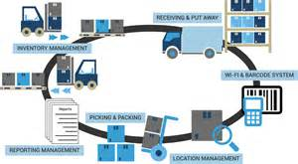
4: Sales and the Customer Experience Are Suffering
As companies grow, one of their biggest challenges is often inventory management. Ensuring that the right amount of products is in the right location at the right time is a vital part of business operations.
When sales, inventory and customer data are maintained separately, it can create serious problems across your company. If you run out of a popular product, sales will be off until the next shipment arrives. Meanwhile, if a customer calls to inquire about an order and employees can't track it to see if it's been shipped—or if it's even in stock—your company will start to develop a poor reputation for reliability and service.
With an ERP system, on the other hand, staff in every department will have access to the same, up-to-the-minute information. Customer-facing reps should be able to answer customers questions about order and shipping status, payment status, service issues, etc., without having to hang up the phone and check with another department. Better yet, customers should be able to simply go online to their account and view status information. Meanwhile, the warehouse manager can see that stock is getting low and can reorder.

Slide 8
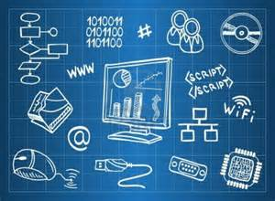
5: Your IT Is Too Complex and Time-Consuming
One of the biggest downsides of having multiple systems across your business is that IT management can become a nightmare. Customizing these systems, integrating them and maintaining them with patches and upgrades can be complex, costly and sap critical time and resources.
If your patchwork of systems includes on-premise, legacy business software, system upgrades can be more trouble than they're worth. Not only are these updates expensive and time-consuming, but they may also undo customizations implemented by IT staff. Given that, it's no surprise that two-thirds of mid-size businesses are running outdated versions of their business software.¹
Rather than adding more software—and complexity—to an already ineffective system, ERP technology can give you the agility to respond to changing business needs rapidly. That's why selecting a cloud-based ERP provider like NetSuite is critical. With NetSuite, system updates are no longer an issue, and new functions are easy to add as your business grows and changes.

Slide 9
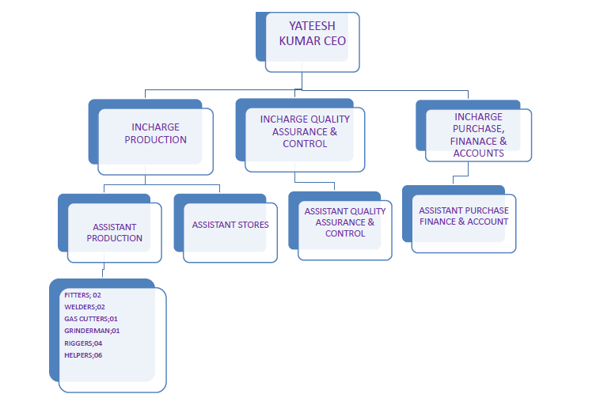
Company Architecture

Slide 10
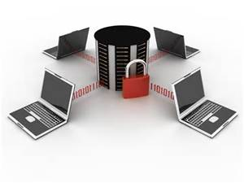
Secure the Database
The database is the core of the ERP application. It contains information about customers and vendors, which usually means that financial information is involved, as well. These databases also often contain the company’s own financial information.
In addition, ERP systems tied into human resources have the potential to expose personally identifiable information of the organization’s employees. This information may be just as valuable to an attacker as the corporate financial information.
When securing the database, begin by ensuring that only necessary information is stored in the database. Extraneous data just add risk implemented with necessary form validation
. Second, make sure that the data are encrypted during transit and storage in the event another security process breaks down and the data are exposed. Encrypting the data can render them almost useless to unauthorized eyes. It is a webtool to encrypt and decrypt text using AES encryption algorithm. You can chose 128, 192 or 256-bit long key size for encryption and decryption. The result of the process is downloadable in a text file.
Finally, make sure that the application and all other touch points of the database have been properly tested for vulnerabilities by a third party; when exploits are found, address them immediately.

Slide 11
Segregate Duties
One of the biggest risks in security is compromise of a user’s credentials. Malicious software can easily record the login process and report back to a command and control server, or a user could fall for a phishing attack that asks him or her to hand over credentials. Either scenario provides the attacker with easy access to the system that runs a low risk of raising red flags.
By segregating certain tasks involved with the ERP system, more than one person are required to complete them. In this way, if one account is compromised, the damage can be reduced, giving IT a better chance of controlling and mitigating it.
Prepared statements are resilient against SQL injection, because parameter values, which are transmitted later using a different protocol, need not be correctly escaped. If the original statement template is not derived from external input, SQL injection cannot occur.

Slide 12
Setting up storing Sessions in a database
I was first introduced to storing Sessions in a database by this great post by Chris Shiflett. Chris provides a perfect introduction to the concept and some sample code to get started. The code in this tutorial is an extension of Chris’ work, and so if you want to read his introduction, you can go do that first.
So in order to store our Session data in a database, we’re going to need a table.
Run the following SQL in your database to generate the table. I’m using MySQL, but hopefully the following should be enough to get you started.
CREATE TABLE IF NOT EXISTS `sessions` (
`id` varchar(32) NOT NULL,
`access` int(10) unsigned DEFAULT NULL,
`data` text,
PRIMARY KEY (`id`)
) ENGINE=InnoDB DEFAULT CHARSET=latin1;

Slide 13
The Session Class
We are going to use a Class to handle our Sessions. This means we can simply instantiate a new Object of the class on each page request. It also keeps all of our Session methods all together in one place.
In order to store the Session data in a database, we are going to need to have a way of interacting with the database. For this tutorial I will be passing the Session class and instance of the Database class that I wrote about in Roll your own PDO PHP Class.
If you want to use your own Database abstraction layer, it should be pretty easy to switch it out. If you haven’t already got a database abstraction layer set up, take a look at that tutorial.
So the first thing we need to do is to create the Class.
class Session {
}
Next we declare a property for the database object we will be using.
/**
* Session
*
/class Session {
/**
* Db Object
*/
private $db;
}

Slide 14
The Constructor
When we instantiate the Session class, we need to set up a couple of things in order to make it work. The constructor method is automatically run when the class is instantiated, and so this is a good place to do just that.
First we instantiate a copy of the database class and store it in the db property.
public function __construct(){
// Instantiate new Database object
$this->db = new Database;
}
Next we need to override the Session handler to tell PHP we want to use our own methods for handling Sessions.
// Set handler to overide SESSION
session_set_save_handler(
array($this, "_open"),
array($this, "_close"),
array($this, "_read"),
array($this, "_write"),
array($this, "_destroy"),
array($this, "_gc")
);

Slide 15
Cont.
This looks complicated, but all it is saying is we want to use our own methods for storing and retrieving data that is associated with the Session. Take a look at the PHP Manual to read more about this.
And finally we need to start the Session.
// Start the session
session_start();
So your constructor method should look like this:
public function __construct(){
// Instantiate new Database object
$this->db = new Database;
// Set handler to overide SESSION
session_set_save_handler(
array($this, "_open"),
array($this, "_close"),
array($this, "_read"),
array($this, "_write"),
array($this, "_destroy"),
array($this, "_gc")
);
// Start the session
session_start();
}

Slide 16
Open
The first method we need to create simply checks to see if there is a database connection available to use.
/**
* Open
*/
public function _open(){
// If successful
if($this->db){
// Return True
return true;
}
// Return False
return false;
}
Here we are simply checking to see if there is a database connection. If there is one, we can return true, otherwise we return false.

Slide 17
Close
Very similar to the Open method, the Close method simply checks to see if the connection has been closed.
/**
* Close
*/
public function _close(){
// Close the database connection
// If successful
if($this->db->close()){
// Return True
return true;
}
// Return False
return false;
}

Slide 18
Read
The Read method takes the Session Id and queries the database. This method is the first example of where we bind data to the query. By binding the id to the :id placeholder, and not using the variable directly, we use the PDO method for preventing SQL injection.
/**
* Read
*/
public function _read($id){
// Set query
$this->db->query('SELECT data FROM sessions WHERE id = :id');
// Bind the Id
$this->db->bind(':id', $id);
// Attempt execution
// If successful
if($this->db->execute()){
// Save returned row
$row = $this->db->single();
// Return the data
return $row['data'];
}else{
// Return an empty string
return ''; }}
If the query returns data, we can return the data. If the query did not return any data, we simple return an empty string. The data from this method is passed to the Global Session array that can be accessed like this:
echo "<pre>";
print_r($_SESSION);
echo "</pre>";

Slide 19
Write
Whenever the Session is updated, it will require the Write method. The Write method takes the Session Id and the Session data from the Global Session array. The access token is the current time stamp.
Again, in order to prevent SQL injection, we bind the data to the query before it is executed. If the query is executed correctly, we return true, otherwise we return false.
/**
* Write
*/
public function _write($id, $data){
// Create time stamp
$access = time();
// Set query
$this->db->query('REPLACE INTO sessions VALUES (:id, :access, :data)');
// Bind data
$this->db->bind(':id', $id);
$this->db->bind(':access', $access);
$this->db->bind(':data', $data);
// Attempt Execution
// If successful
if($this->db->execute()){
// Return True
return true; }
// Return False
return false;
}

Slide 20
Destroy
The Destroy method simply deletes a Session based on it’s Id.
/**
* Destroy
*/
public function _destroy($id){
// Set query
$this->db->query('DELETE FROM sessions WHERE id = :id');
// Bind data
$this->db->bind(':id', $id);
// Attempt execution
// If successful
if($this->db->execute()){
// Return True
return true;
}
// Return False
return false;
}
This method is called when you use the session destroy global function, like this:
// Destroy session
session_destroy();

Slide 21
Implementation Method : Big Bang Approach
The phrases ‘big bang’ and ‘phased’ are used to describe ERP strategies for introducing new systems into an organisation. A ‘big bang’ ERP implementation is typically used to describe a go-live or cutover scenario where a business switches from their old ERP system to their new system at a single point in time. In contrast, a ‘phased’ approach describes a scenario where elements or modules of the ERP system are introduced in a planned sequence, replacing the old systems gradually.

Slide 22
Cont.
The three phases of big bang approach are as follows
1.The first phase would be to conduct a short study to determine the scope of project which would provide a base to outline the blueprint and costing.A specific body would be formed who will monitor the finanace of the project along with controlling the genuine implementation process.
2.In the second phase,a detailed planned would be created and a prototype system would be installed,These phase would be very crucial where the model would be developed based on previous implementation models and all existing projects would be drawn together and merged.In this stage a review regarding a whole module would be conducted based on the result derived from the prototype and any suggestions would be considered.

Slide 23
Cont.
3.Finally, in third stage the actual module would be implemented.But since this phase would be too large ,the implementation would be made in two waves.Both the physical and architecture would be taken into consideration during the execution process.The first wave would deal with replacing the older system with a new erp system where prototype would act as a foundation for the ultilate implementation process.in the second wave the necessary infrastructure would be set in place; the employees would be thoroughly trained to use the new desired erp system.During this wave,the older system would be set to ‘view only’ mode as SAP would become a primary system.Once the new system provide some positive responsive ,the older system would be completely eradicated.

